Slide 1
Proficiency and Performance: Speaking the Language of Language Learning
DECTFL Fall Conference
October 6, 2017

Slide 2
Introductions

Slide 3
Learning Targets
I can explain what proficiency and performance are and how they impact language learning in my classroom.
I can identify levels of proficiency and performance.
I can explain the relationship between proficiency and performance and the state world language standards.
I can explain state proficiency targets and my course performance targets to my students.
(cc) villarreal15

Slide 4
Proficiency vs. Performance
LEARNING LANGUAGE?
(cc) villarreal15
Notes:
On post-it, write out what you know already about the differences between Proficiency and Performance.
Read description from ACTFL Performance Guidelines—what was reinforced or what aha did you have?
PowerPoint from Alyssa Villarreal, Shelby County, TN: http://scsworldlanguages.weebly.com/.

Slide 5
Language
Learning
(cc) villarreal15
Notes:
Language learning is like this brick wall

Slide 6
Performance
(cc) villarreal15
Notes:
As we learn languages we practice and engage in performances that are represented by the individual bricks. (Provide students with examples of how these performances will occur in your classroom here. Such as performance assessments… how will they use language in your classroom?)

Slide 7
Multiple Performances
(cc) villarreal15
Notes:
As we continue through the year we continue to complete various performances based on what we are learning. While the content changes, we are still working on reinforcing our communication skills with new information. For example in Unit one we may talk about what you like and do not like to do and in unit 3 we may talk about our family but we are still working on the Skill of asking and answering questions.

Slide 8
CEMENT
(cc) villarreal15
Notes:
Your practice is the cement that holds the performances together. When they are stuck together they form

Slide 9
(cc) villarreal15
Notes:
The wall is the the proficiency level.

Slide 10
What’s the Difference?
Performance
Proficiency
What we do in the classroom
Communication we practice
The skills that underlie the communication across topics
Can communicate on any topic
(cc) villarreal15
Notes:
Proficiency is the ability to use language in real world situations in a spontaneous interaction and non-rehearsed context and in a manner acceptable and appropriate to native speakers of the language. Proficiency demonstrates what a language user is able to do regardless of where, when or how the language was acquired. The demonstration is independent of how the language was learned; the context may or may not be familiar; the evaluation of proficiency is not limited to the content of a particular curriculum that has been taught and learned.

Slide 11
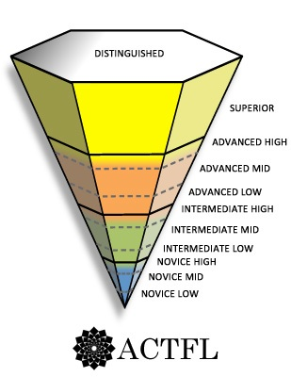
How will I know how I am doing?
Performance and Proficiency are measured on the same ACTFL Proficiency Scale.
(cc) villarreal15
Notes:
What does the visual tell us about performance and proficiency?

Slide 12
Speaking the Language of Proficiency and Performance
The Martian and the Circus
Notes:
In groups, complete the Circus activity.

Slide 13
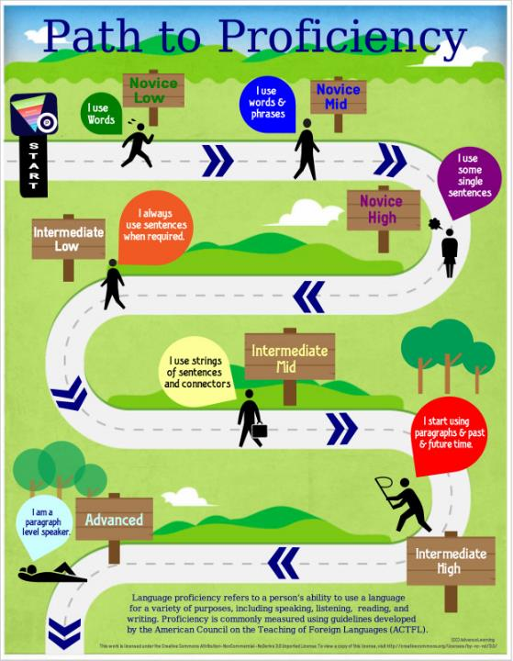
This is you
on your Path to Proficiency…
(cc) villarreal15
Notes:
Share State Proficiency Targets

Slide 14
FAIL FORWARD
FAIL FORWARD!
Notes:
We do not get better if we do not try! This means we will make mistakes. What is important is not that we made a mistake but that we learn from it. If we did everything perfectly we wouldn’t ever learn! This is your opportunity to master failing forward!

Slide 15
STEPS to PROFICIENCY
NOVICE HIGH
NOVICE MID
NOVICE LOW
NOVICE
(cc) villarreal15
(cc) villarreal15

Slide 16
STEPS to PROFICIENCY
NOVICE HIGH
NOVICE MID
NOVICE LOW
Uses isolated Words
NOVICE
(cc) villarreal15

Slide 17
STEPSto PROFICIENCY
NOVICE HIGH
NOVICE MID
Topic specific Lists & phrases
NOVICE LOW
NOVICE
(cc) villarreal15

Slide 18
STEPS to PROFICIENCY
NOVICE HIGH
Production consists of
primarily lists, phrases,
fragments of
sentences, and chunks
of language related to
the topic or task.
NOVICE MID
NOVICE LOW
NOVICE
(cc) villarreal15

Slide 19
STEPS to PROFICIENCY
Intermediate
High
Intermediate
Mid
Intermediate
Low
Intermediate
(cc) villarreal15

Slide 20
STEPS to PROFICIENCY
Intermediate
High
Intermediate
Mid
Intermediate
Low
Production consists of
a combination of
sentences, phrases,
and sentence
fragments related to
the topic and task.
Intermediate
(cc) villarreal15

Slide 21
STEPS to PROFICIENCY
Intermediate
High
Intermediate
Mid
Strings of sentences
created by the speaker
related to topic and
task.
Intermediate
Low
Intermediate
(cc) villarreal15

Slide 22
STEPS to PROFICIENCY
Intermediate
High
Simple paragraphs with some connected, detailed sentences.
Intermediate
Mid
Intermediate
Low
Intermediate
(cc) villarreal15

Slide 23
How does this work in class?
In each unit you will have a variety of performances.
For each performance, whether spoken or written, you will receive achieve a performance level.
To improve look at the next level and compare with the level you achieved. What do you need to improve?
(cc) villarreal15

Slide 24
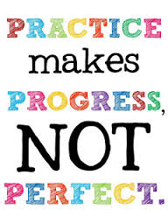
SO...
Let’s
Practice!
(cc) villarreal15

Slide 25
Name that Level …
You will see a series of performance descriptors on the following slides.
Write the level you believe is being represented on your notecard.
When given the cue, hold up your answer.
(cc) villarreal15
Notes:
Using paper, hold ups or white boards, have students hold up the level name that best describes the performance level being described.
(you can make whiteboards from white card stock and a multi-page capacity page protector.)

Slide 26
1.
Choices: Novice Low, Novice Mid, Novice High, Intermediate Low, Intermediate Mid, Intermediate High
Words or no target language production
(cc) villarreal15
(cc) villarreal15

Slide 27
1.
Choices: Novice Low, Novice Mid, Novice High, Intermediate Low, Intermediate Mid, Intermediate High
Novice LOW
(cc) villarreal15

Slide 28
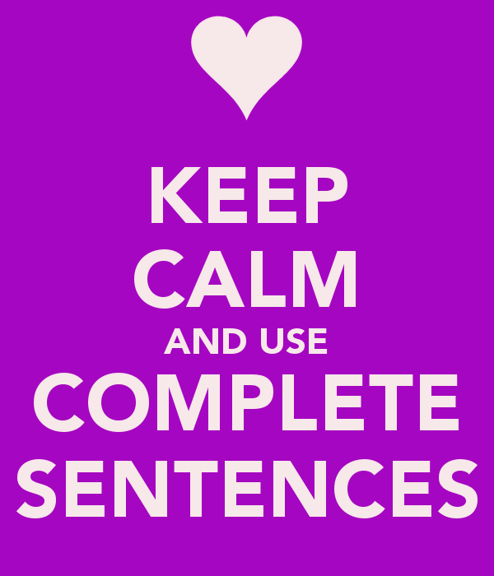
2.
Choices: Novice Low, Novice Mid, Novice High, Intermediate Low, Intermediate Mid, Intermediate High
Production consists of discrete sentences related to the topic and task.
(cc) villarreal15

Slide 29
2.
Choices: Novice Low, Novice Mid, Novice High, Intermediate Low, Intermediate Mid, Intermediate High
Production consists of discrete sentences related to the topic and task.
Intermediate Low
(cc) villarreal15
(cc) villarreal15

Slide 30
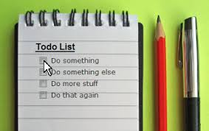
3.
Choices: Novice Low, Novice Mid, Novice High, Intermediate Low, Intermediate Mid, Intermediate High
Uses words, lists & phrases
(cc) villarreal15

Slide 31
3.
Choices: Novice Low, Novice Mid, Novice High, Intermediate Low, Intermediate Mid, Intermediate High
Uses words, lists & phrases
Novice Mid
(cc) villarreal15

Slide 32
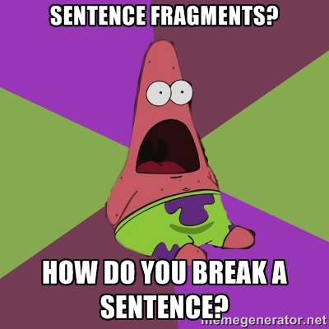
4.
Choices: Novice Low, Novice Mid, Novice High, Intermediate Low, Intermediate Mid, Intermediate High
Sentence Fragments & occasional sentences.
(cc) villarreal15

Slide 33
4.
Choices: Novice Low, Novice Mid, Novice High, Intermediate Low, Intermediate Mid, Intermediate High
Novice
High
Sentence Fragments & an occasional sentences.
(cc) villarreal15

Slide 34
5.
Choices: Novice Low, Novice Mid, Novice High, Intermediate Low, Intermediate Mid, Intermediate High
I always use strings of sentences and connectors.
(cc) villarreal15

Slide 35
4.
Choices: Novice Low, Novice Mid, Novice High, Intermediate Low, Intermediate Mid, Intermediate High
I always use strings of sentences and connectors.
Intermediate High
(cc) villarreal15

Slide 36
6.
Choices: Novice Low, Novice Mid, Novice High, Intermediate Low, Intermediate Mid, Intermediate High
I use sentences and occasional strings of sentences
(cc) villarreal15

Slide 37
6.
Choices: Novice Low, Novice Mid, Novice High, Intermediate Low, Intermediate Mid, Intermediate High
I use sentences and occasional strings of sentences
Intermediate Mid
(cc) villarreal15

Slide 38
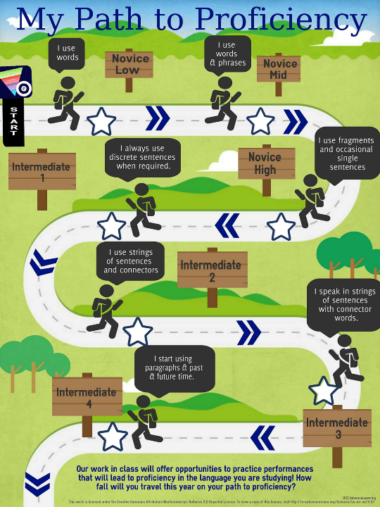
Where do you want to
go on your Path to Proficiency this year?
(cc) villarreal15
Notes:
Have students color the star that represents where THEY want to score by the en of the year.

Slide 39
Proficiency, Performance and the Standards
Goals
Standards
Proficiency/Performance Global Statements
Proficiency/Performance Indicators

Slide 40
Self-Assessment
I can explain what proficiency and performance are and how they impact language learning in my classroom.
I can identify levels of proficiency and performance.
I can explain the relationship between proficiency and performance and the state world language standards.
I can explain state proficiency targets and my course performance targets to my students.
(cc) villarreal15

Slide 41
Thanks …
Alyssa Villarreal, Shelby County Public Schools, TN:
http://scsworldlanguages.weebly.com/

